Slide 1
Introduction to PennPathways 2.0 and AgileMD
Key Contacts:
Emilia J. Flores, RN, PhD
Nikhil Mull, MD
Rachael Rider, MHA
Joy Iocca, RN
John McGreevey, MD

Slide 2
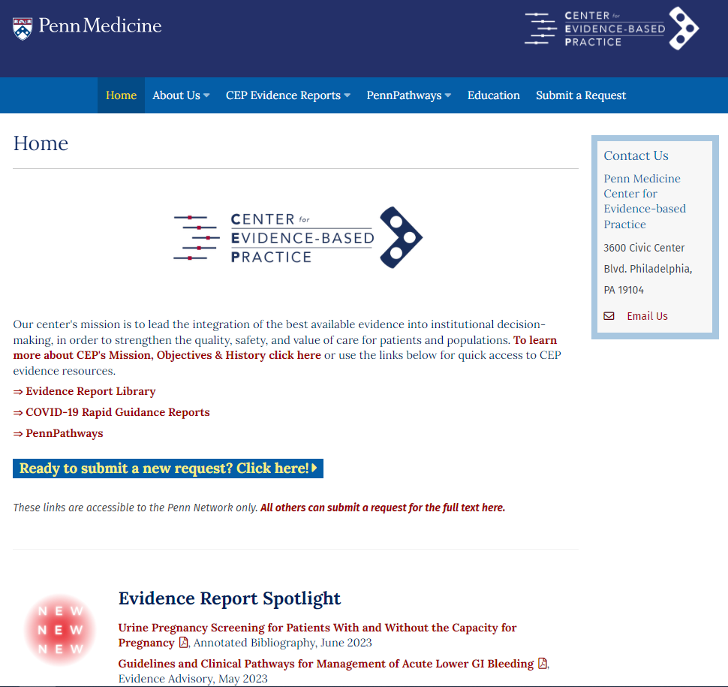
What is PennPathways?
www.med.upenn.edu/CEP/
Program supported by the Center for Evidence-based Practice
Evidence-based clinical pathways, developed / approved by Penn Medicine clinicians, for use specifically in the Penn Medicine environment
10 step framework for developing/disseminating pathways
~400 pathways to date
Mission is to lead the integration of best evidence into decision making to strengthen the quality, safety, and value of care.
Also focus on clinician usability of clinical pathways and PennChart decision support hooks.

Slide 3
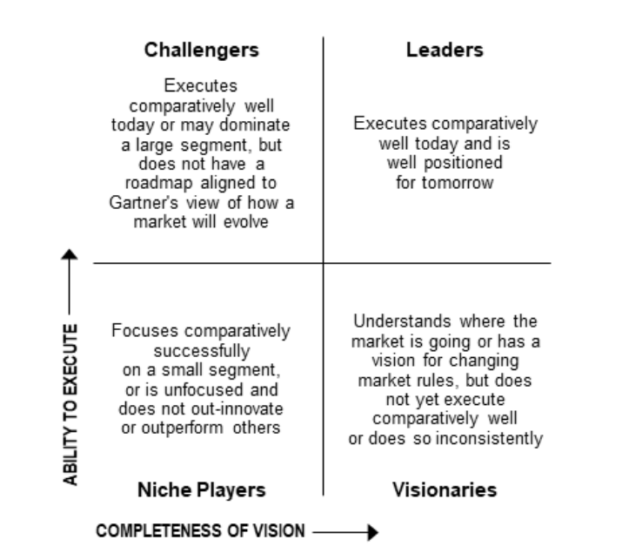
Why AgileMD?
Contract ending with Dorsata
Penn must have a solution to house our existing industry leading PennPathways and enable PennChart integration
Note: this is different from Epic Care Pathways and Epic Pathways.
CEP conducted a vendor evaluation ~2019
2020/2021: Kevin Mahoney asked Bill Hanson / CMIO group to review AgileMD
AgileMD
Key player in pathway-EMR integration space
Proven track record with Epic Clients (App Orchard availability)
NOT a start up (11 years old)
Due diligence with existing AgileMD customers
AgileMD eager to work with Penn, offering great support and guidance

Slide 4
AgileMD is used by many similar health systems
This tool can be used by ALL members of the healthcare team
Nurses,
pharmacists,
PT/OT,
RT
Physicians,
Advanced practice providers
In inpatient and outpatient settings
700+ pathways
300+ pathways
Slides used with Permission from AgileMD CEO, Borna Safabakhsh

Slide 5
Project overview
Project sponsors: PJ Brennan, Bill Hanson
Workstreams
Workstream 1: Legacy system conversion (Dorsata content --> agile)
Workstream 2: PennChart Environment Prep to enable pathway integration
Workstream 3: Pilot pathways: design, build, release, monitor, evaluate
Core team (to date)
2 and 3 happing concurrently
CEP | CMIO | IS
Emilia Flores | Joy Iocca | Anna Schoenbaum
Nikhil Mull | John McGreevey | Kim McClellan
Ryan Greysen |  | Jon Pomeroy
 |  | Mika Epps

Slide 6
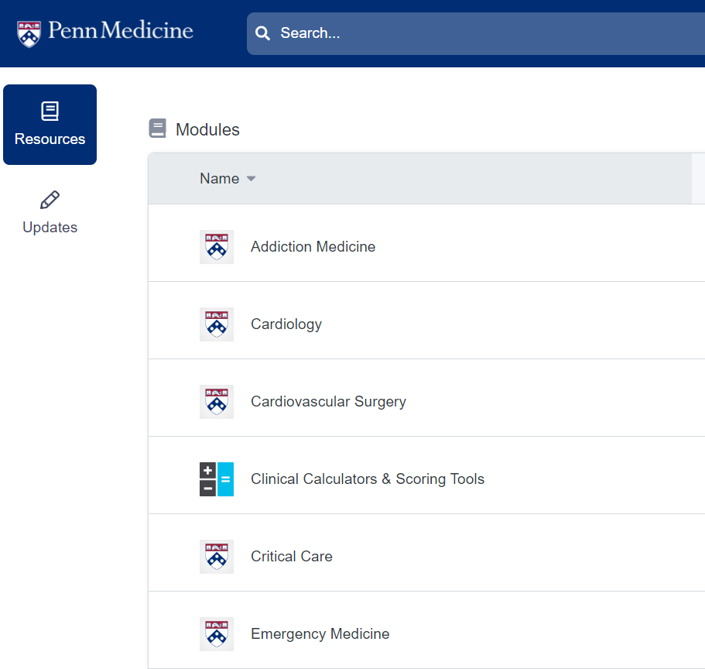
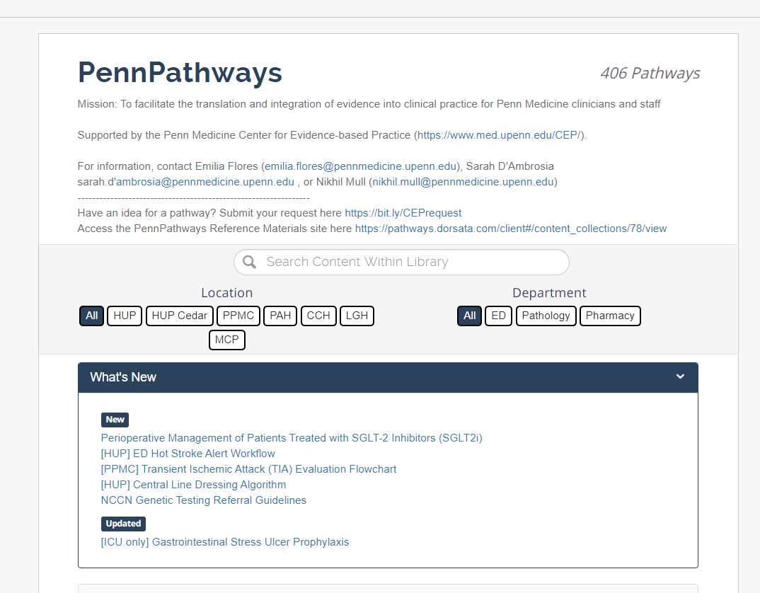
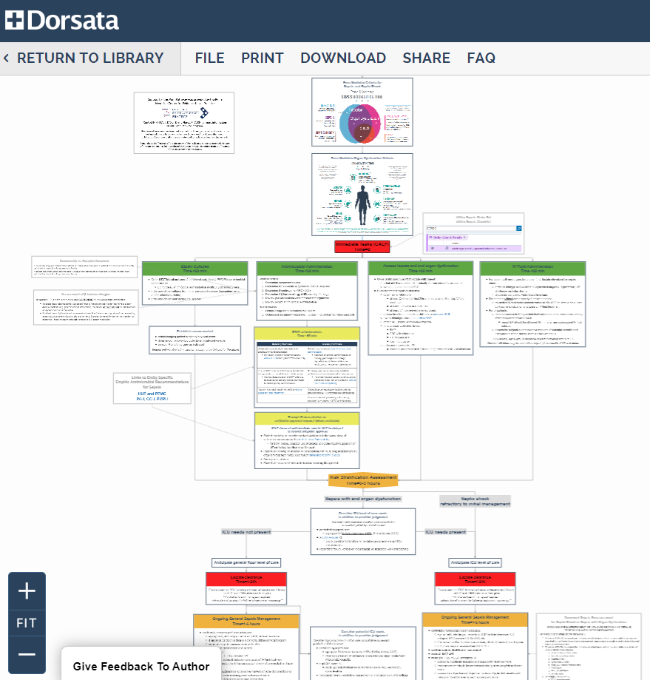
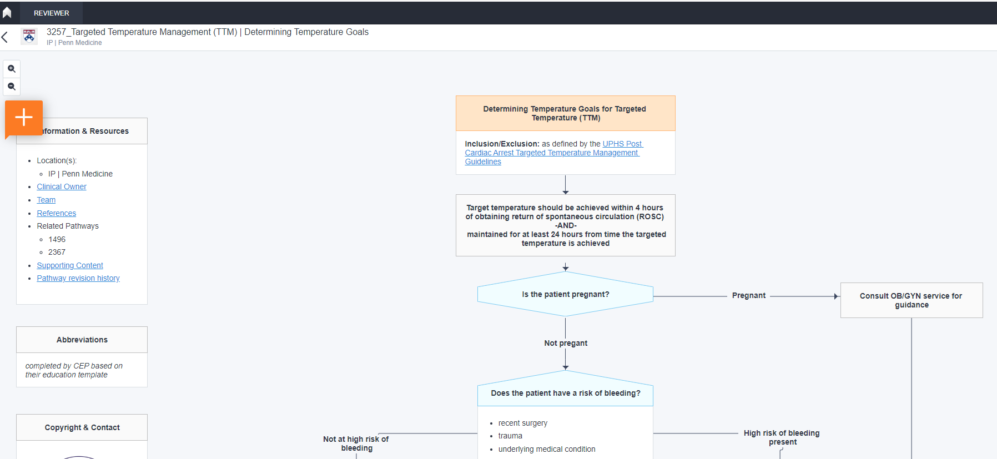
MIGRATE PennPathways on the Dorsata production platform + pathways in the preproduction environment to the AgileMD platform – July 1 go-live

Slide 7
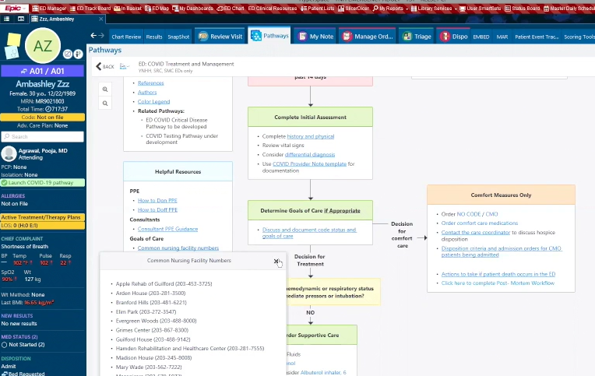
Other changes to pathways
View all pathways from within PennChart (August)
Ability to define triggers for pathway recommendation, based on patient data (when viewing from PennChart)
Enhanced analytics capabilities for QI and process improvement work
Ability to embed other important operational guidance directly in the pathway
CEP evidence reports
Calculators
Other related pathways
Commonly used/needed contact information, phone numbers
Notes:
Emilia

Slide 8
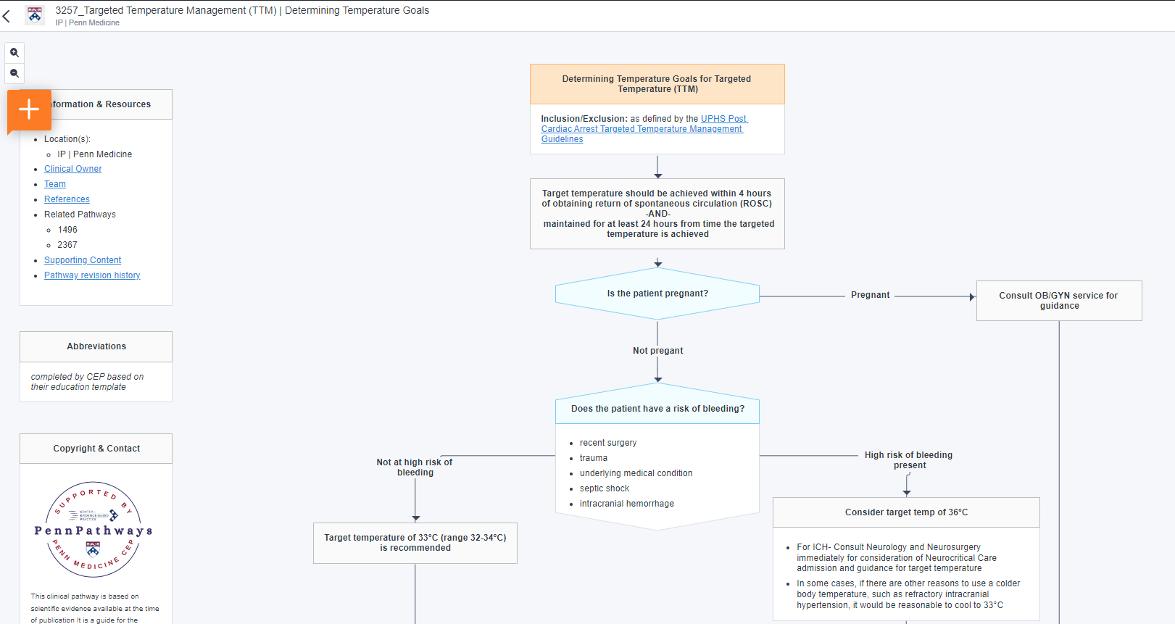
Now two options for structuring pathway content
Other changes to pathways
Standard flowchart / pathway

Slide 9
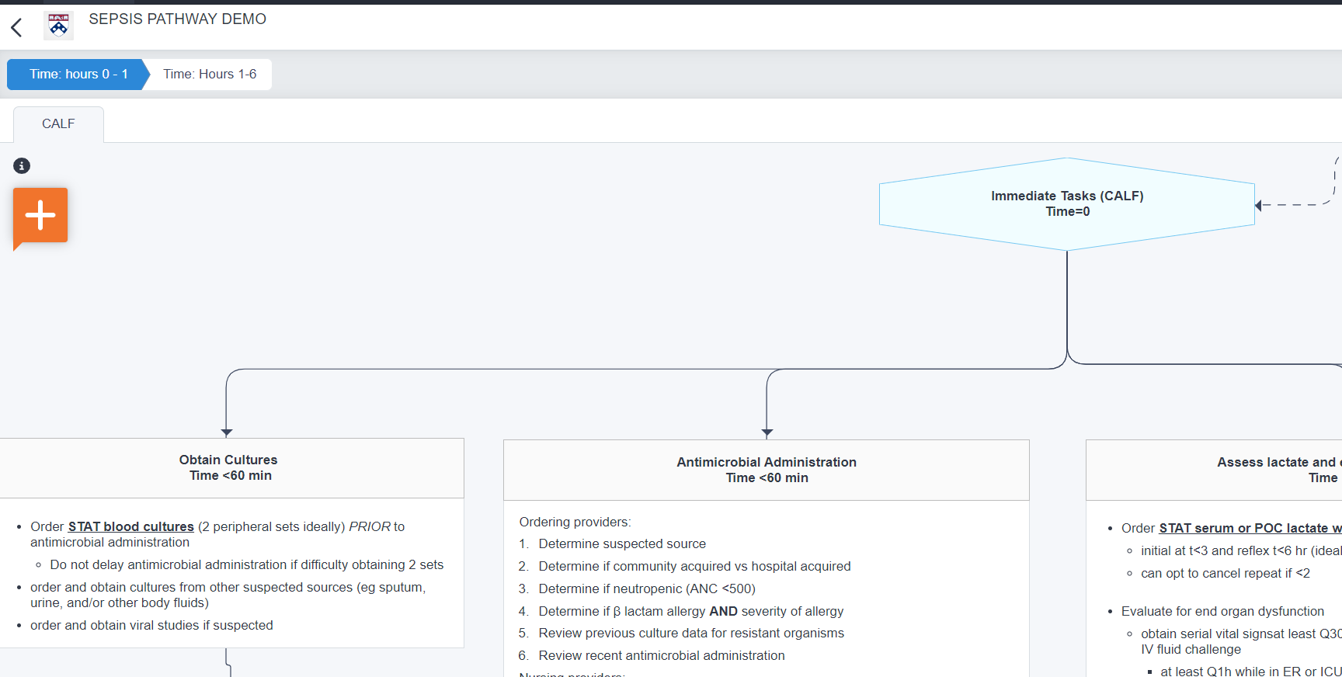
Other changes to pathways
Now two options for structuring pathway content
Tab style

Slide 10
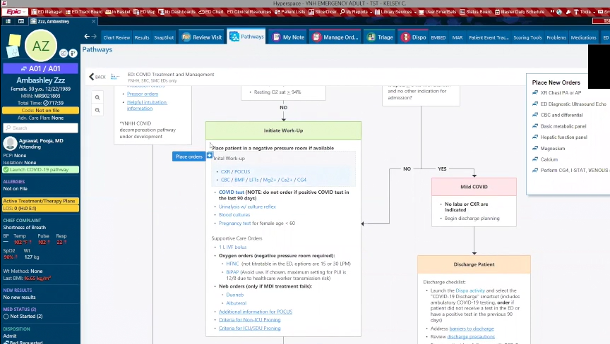
Other changes to pathways
Detailed analytics will be available for pathways used from within PennChart
Examples
Report on pathway users by entity, department
Reports on proportion of orders placed from the pathway vs. other means
By pathway
By entity
By department
By user
Proportion of patients where pre-defined pathway milestones achieved
(Workstream 2)

Slide 11
AgileMD Key Milestones (Workstream 1)
Conversion Dorsata → Agile
Dorsata will be replaced by Agile on July 1, 2023
Dorsata will not be available after this date
PennPathways will still be accessible in all the usual ways
All exiting pathways will be viewable in Agile AND in PennChart
All Dorsata links in PennChart / Policies / Intranet sites replaced with Agile links
~ 3-5 pathways will be available in Agile format at go-live
Remaining will appear as a PDF with plan in place for conversion
Dorsata app on shared iPhones will be replaced by a shortcut to mobile friendly Agile website
No more account required for mobile viewing!
Can text, email, print pathways directly from the phone

Slide 12
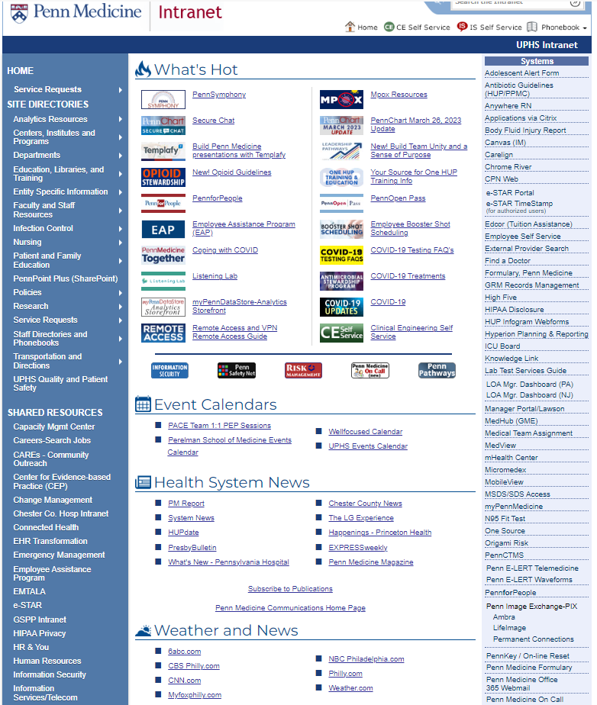
FOUR ways to access / use PennPathways:
PennChart
UPHS links >> Algorithm >> PennPathways
Existing links in orders, lab results, etc.
Intranets: UPHS and all entity. All existing links on intranets/ sharepoint site will be replaced
Mobile App
all shared iPhones/ SCiP will have shortcut to Agile
Workstream 1, July 1

Slide 13
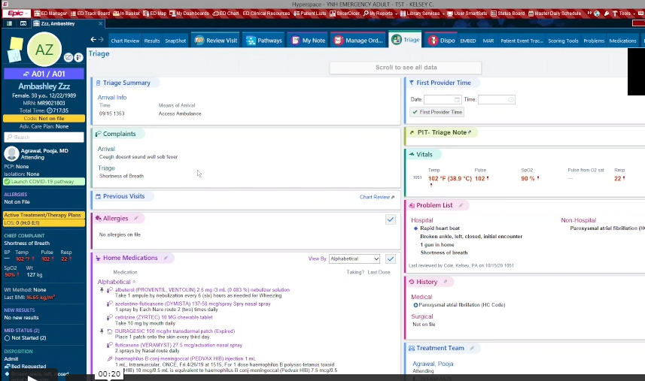
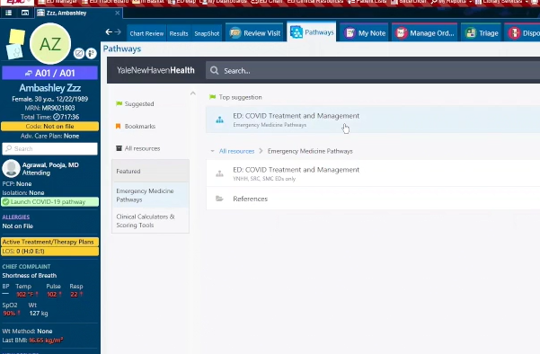
4. PennChart
ALL pathways will be viewable from PennChart via the pathways tab
SELECT pathways initially will be deeply integrated into PennChart
(Workstream 2)
Notes:
Emilia

Slide 14
Deep integration of pathways in PennChart – Overview of new features
Place orders from the pathway
Review lab results from the pathway for decision making
Write data to flowsheets
Orders placed from the pathway will transfer to the orders activity for signing
Tool offers full transparency to the user
(Workstream 2)
Notes:
Emilia

Slide 15
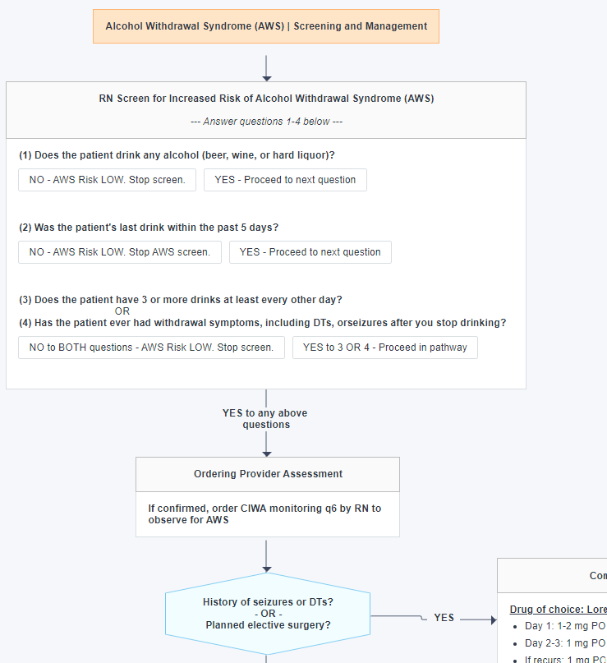
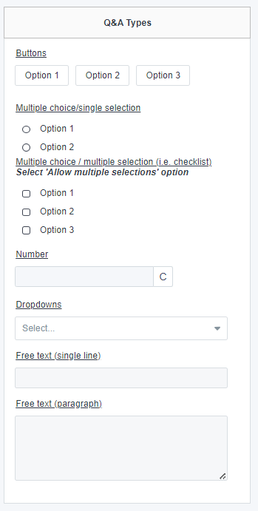
Deep integration of pathways in PennChart – Overview of new features
Embed links to other areas of PennChart e.g., tabs, navigators, notes, etc.
Embed calculators
Visual cues to know where someone left off on the pathway
Create custom question & answer in a pathway.
Answers can be saved for this encounter or patient and viewed by other team members
Example alcohol withdrawal screening at the beginning of a patient encounter
Answers to the screen questions are visible to all members of the healthcare team
Other question types are available
(Workstream 2)
Notes:
Emilia

Slide 16
PennPathways 2.0 to support new needs and increased demand
Focus on support for alliance, committee, disease team requests (consensus building and stakeholder management)
Assumptions:
Problem definition and scoping; inclusion, exclusion criteria; identify evidence-basis; develop a draft algorithm and achieve consensus.
Deliverable: evidence-based algorithm with sign off by stakeholders
Priority for request that can be deeply integrated into PennChart (can and will be implementable)
Robust analysis of impact
Assumptions:
4 months post intervention data
Analytics support from Penn DnA

Slide 17
Key Contacts:
Emilia J. Flores, RN, PhD
Nikhil Mull, MD
Rachael Rider, MHA
Joy Iocca, RN
John McGreevey, MD

